Slide 1
Android development tools

Slide 2
Elements of Android Projects
Application Name
seen by users on app chooser, app list, store
Project Name
in IDE, can be different, often directory
Package Name
Java package name, not using default package
Minimum SDK version
how far back of API level do you support, ~16 as of Jan 2017
Compile SDK version
SDK version (PI level) where your app has been complied. it is strongly recommended that you always compile with the latest SDK.
Target SDK version
Level of API you had in mind for app, most recent?
Theme
look and feel of app, color scheme, various built in themes such as Theme, Holo, Material (Design)

Slide 3
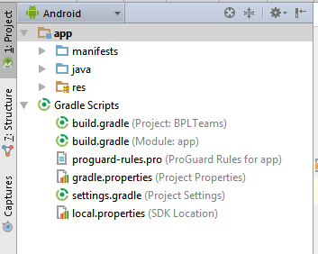
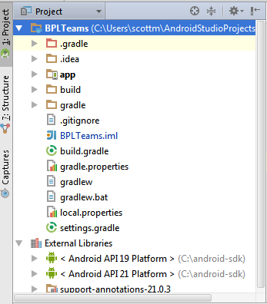
Android Projects
Android Project View
Classic Project View

Slide 4
Android Project Components

Slide 5
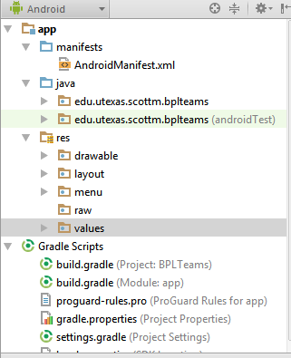
Android Project Components - Manifests
AndroidManifest.xml
Like a table of contents for your app
Main activity
Explicit and Implicit Intent Filters
Declare all the parts of your apps:
Application package name, activities, services, broadcast receivers, icon, theme
Request permissions
network, location, ...
Notes:
** Every app project must have an AndroidManifest.xml file (with precisely that name) at the root of the project source set. The manifest file describes essential information about your app to the Android build tools, the Android operating system, and Google Play.
The app's package name, which usually matches your code's namespace.
The components of the app, which include all activities, services, broadcast receivers, and content providers.
The permissions that the app needs in order to access protected parts of the system or other apps.
The hardware and software features the app requires, which affects which devices can install the app from Google Play.
Every application must have an AndroidManifest.xml file (with precisely that name) in its root directory. The manifest presents essential information about the application to the Android system, information the system must have before it can run any of the application's code. Among other things, the manifest does the following:
It names the Java package for the application. The package name serves as a unique identifier for the application.
It describes the components of the application — the activities, services, broadcast receivers, and content providers that the application is composed of. It names the classes that implement each of the components and publishes their capabilities (for example, which Intent messages they can handle). These declarations let the Android system know what the components are and under what conditions they can be launched.
It determines which processes will host application components.
It declares which permissions the application must have in order to access protected parts of the API and interact with other applications.
It also declares the permissions that others are required to have in order to interact with the application's components.
It lists the Instrumentation classes that provide profiling and other information as the application is running. These declarations are present in the manifest only while the application is being developed and tested; they're removed before the application is published.
It declares the minimum level of the Android API that the application requires.
It lists the libraries that the application must be linked against.

Slide 6
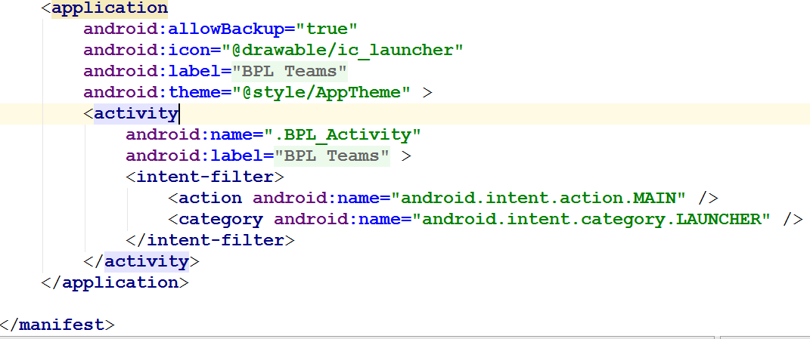
Android Manifest - Sample

Slide 7
Android Project Components - Java Source Code
Source Code:
In java directory in Android Project View
Actually in src directory on system

Slide 8
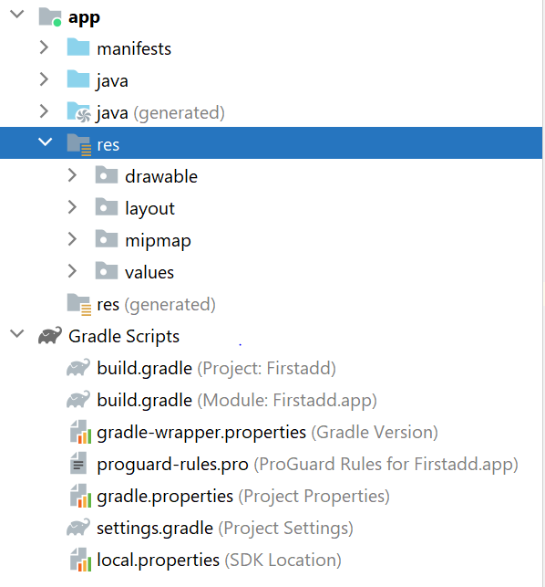
Android Project Components - Resources
Resources or the res directory
Resources are the additional files and static content that your code uses, such as bitmaps, layout definitions, user interface strings, animation instructions, and more.
Packaged up with app
Plays a large role and has multifaceted use in development of app.

Slide 9
Resource Directories
res/drawable for graphic images such as png, jpeg
res/layout for xml files that define the layout of user interfaces inside the app
res/menu for xml based menu specifications
res/values for lists of strings, dimensions, colors, lists of data
res/raw for other kinds of files such as audio clips, video clips, csv files, raw text
res/xml for other general purpose xml files
res/mipmap for drawable files for different launcher icon densities.

Slide 10
Gradle
Every Android project needs a gradle for generating an APK from the .java and .xml files in the project
APK or Android Package or Android Package Kit
APK files allow you to install apps on your Android phone. (JAR)
Two types
Top level build.gradle: Top level Configurations
Module-level build.gradle: Dependencies and SDK version.

Slide 11
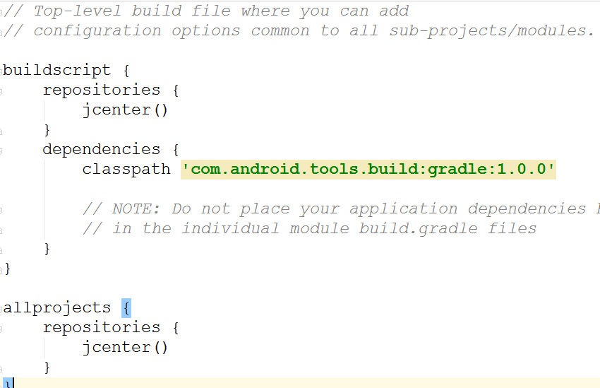
sample build.gradle file - PROJECT

Slide 12
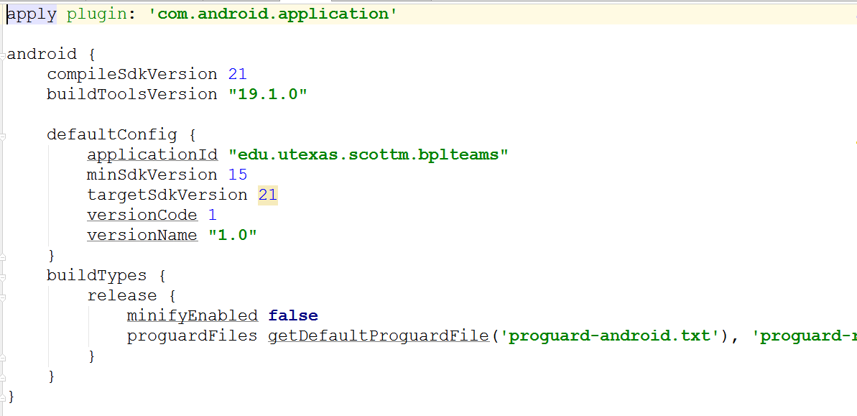
sample build.gradle file - MODULE / APP

Slide 13
emulators

Slide 14
Android Emulator or Android Virtual Device (AVD)
Emulator is useful for testing apps but is not a substitute of a real device
Emulators are called Android Virtual Devices (AVDs)
Android SDK and AVD Manager allows you to create AVDs that target any Android API level
AVD have configurable resolutions, RAM, SD cards, skins, and other hardware

Slide 15
Android Runtime: Dalvik VM
Subset of Java developed by Google
JVM vs DVM ?
Optimized for mobile devices (better memory management, battery utilization, etc.)
Dalvik executes .dex files that are compiled from .class files
Introduces new libraries
Does not support some Java libraries like AWT, Swing
Notes:
JVM was designed for Java, by keeping Desktop applications in mind. The major difference between Desktop, and mobile is that mobiles have a very limited amount of memory (RAM) and less CPU speed compared to desktops and laptops. JVM is very heavyweight and requires a lot of RAM and CPU speed to execute a program. Since mobiles can't afford that much RAM and CPU, Android needs a more optimized and lightweight version of the JVM. The DVM was created to replace the JVM. The DVM is meant for embedded devices that have less RAM and CPU speed.
https://www.c-sharpcorner.com/UploadFile/34ef56/android-application-build-process-or-compilation-process/

Slide 16

Producing an Android App
Java code
javac
Byte code
Dalvik exe file
(DEX)
dx
.java
.class
classes.dex
apkbuilder
Byte code
<xml>
Other .class files
AndroidManifest.xml
.apk
<str>
Resources
Notes:
-The javac command reads source files that contain module, package and type declarations written in the Java programming language, and compiles them into class files that run on the Java Virtual Machine. (Javac = Java compiler)
- DEX: full form is the Dalvik EXecutable file. The DVM executes only DEX files. A DEX file is a compressed version of all .class files, in such a way that DEX will be loaded very quickly, takes less memory, and is executed quickly compared to .class files. A DEX file requires less memory compared to .class files.
dx: this is the tool used to convert all .class files into a single DEX file. This tool comes with the Android SDK.
AP: full form is an Android Application Package file. This is the final file of any Android application that can be loaded into an emulator or device for execution. You can think of it as a .exe file. If you have a .apk file for an Android application then it can be loaded into Android devices and will run.
APK file = DEX file + zipped resources + any native libraries (non-Java).
apkbuilder: is the tool that will generate a .apk file from a DEX file + non-Java libraries + zipped resources.

